Slide 1
PRECISION AYURVEDIC MEDICINE PREDICTION
JAIKARTHIK.M 2013103616
SHRUTHI.S 2013103069
SHIFANA BEEVI.S 2013103604
UNDER THE GUIDANCE OF
DR.AROCKIA XAVIER ANNIE,
ASSISTANT PROFESSOR,
COMPUTER SCIENCE DEPARTMENT,
CEG,ANNA UNIVERSITY,
CHENNAI-25

Slide 2
INTRODUCTION:
Chronic disease has been the number one cause of death as well as a disability in India with the host of
i) immune disorders
ii) cancer
iii) cardio-vascular problems
iv) lifestyle disorders
v) dermatological problems and so on.
As a complement to modern medicine's approach on treating such illnesses at the symptomatic level, Precision Ayurvedic Medicine Prediction with its focus on “root cause” treatment by identifying the body type(Vata, Pitta, Kapha) through
i) diet
ii) lifestyle
iii) emotional
iv) physical
v) fitness features
and the disease, is an effective and low-cost preventive and curative solution.

Slide 3
OBJECTIVE:
Precision Ayurvedic Medicine Prediction is a model which proposes a usable way of predicting the ayurvedic medicine to be used among patients for their diseases.
Identification of body type: Vata, Pitta, Kapha has to be identified by enquiring the person's mental, emotional, physical and fitness features.
Clustering of data sets: All possible symptoms will be collected and the corresponding diseases will be tabulated along with ayurvedic medicines. This involves many to many mapping i.e. responding to acute variations.
Disease prediction: The symptoms will be enquired from the user and their disease will be mapped.
Medicine suggestion: Along with medicines, the root/shrub needed to prepare those medicines will also be prescribed.

Slide 4
Since ayurveda is herbal and natural care system, ayurvedic products are completely safe and subtly eliminates the cause of disease.
Precision Ayurvedic Medicine Prediction will be of greater use to identify which medicine is to be used to which disease and the ingredients needed in preparing those medicines.

Slide 5
LITERATURE SURVEY
Optimal Drug Prediction From Personal Genomics Profiles
Jianting Sheng, Fuhai Li, and Stephen T. C. Wong
IEEE JOURNAL OF BIOMEDICAL AND HEALTH INFORMATICS, VOL. 19, NO:4, JULY 2015
PURPOSE:
Although sub-typing analysis has identified patient subgroups sharing common biomarkers, there is no effective method to predict the drug response of individual patients precisely and reliably.
FINDING:
The experimental analysis lead to a drug prediction routine that can be used to improve greatly the reliability of finding optimal drugs for individual patients and
will, thus, form a key component in the precision medicine infrastructure

Slide 6
V.A.Shiva Ayyadurai’s published paper on the Rosetta Stone for Siddha and Ayurveda discusses that,
The systems biology of Siddha and Ayurveda provides two important features that today’s modern systems biology seeks to replicate:
1.Holism
2 .Personalisation, within a framework of control systems engineering.
The systems biology of Siddha and Ayurveda recognised fundamentally that health and well-being had to be personalised, and the concept of the individual Prakriti provides a mechanism to personalise care to find the right therapies that enable the individual to find an optimal of health that may be very different for another individual.

Slide 7
S.NO | PAPERS/ARTICLES | PROS | CONS
1 | Chatterjee B, Pancholi J.,Prakriti - based medicine: A step towards personalized medicine. Ayu.2011;32:141–6[PubMed] | Puts forth Ayurveda's holistic approach and its emphasis on prevention and the potential to improve health status. | No systematic integration of prakriti based medicines yet.
2 | Heather Collins,Sherri Calvo,Kathleen Greenberg, Forman Neall,Stephanie Morrison,Information Needs in the Precision Medicine Era: How Genetics Home Reference Can Help,2016 April | States the importance of research into consumers specific information needs related to precision medicine could help guide the evolution of existing educational resources and the development of new resources. | Deals with allopathy and genetic testing and not ayurveda

Slide 8
S.NO | PAPERS/ARTICLES | PROS | CONS
3 | Precision medicine for advanced prostate cancer, Stephanie A. Mullane, Eliezer M. Van Allen, PMC 2016 Jul 21. | The concept of precision medicine driven by cody characteristics for CRPC | The stratification is applicable only for CRPC Precision medicine is based on allopathy.
4 | Clusters of Ayurvedic Medicines Using Improved K-means Algorithm, Kajal C. Agarwal and Meghana Nagori, ISBN: 978-981-07-5461-7,2013 | This paper discusses the Importance of Ayurveda,standard k-means and improved k-means clustering algorithm and its implementation to form clusters of ayurvedic medicine for four Disease. | Automation for chronic diseases are missing. Implementation of medicine prediction given the symptoms are highly possible.

Slide 9
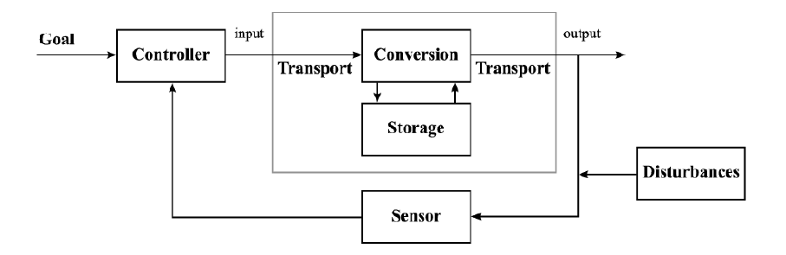
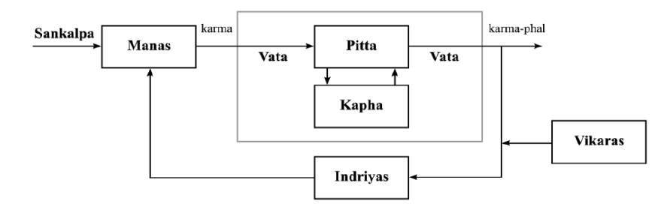
CLOSED LOOP SYSTEM:
REGULATORY CYCLE OF SIDDHA AND AYURVEDA:

Slide 10
PROPOSED SYSTEM:
FEATURES:
Quiz to identify body type (Vata, Pitta, Kapha).
Clustering the data sets.
Provided the symptoms, identifying the disease.
Medicine suggestion.
Projecting the ingredients needed to produce those medicines.
Integrating it into a web application using shiny R.

Slide 11
NEED OF THE PROJECT:
There are numerous websites, references and links available worldwide for allopathy medicines.
But, when Ayurveda is concerned, there is no proper consistent website from India which will provide us with the details that this project is supposed to do.
Also, the cost of ayurvedic medicines are less when compared to allopathy.

Slide 12
SCOPE OF THE PROJECT:
Precision Ayurvedic Medicine Prediction can be used by any individual all over the world and get to know his/her problems and appropriate solutions.
This project can also be provided to many health care units for quicker response to patients.
When converted to an android app, it becomes easily portable.

Slide 13
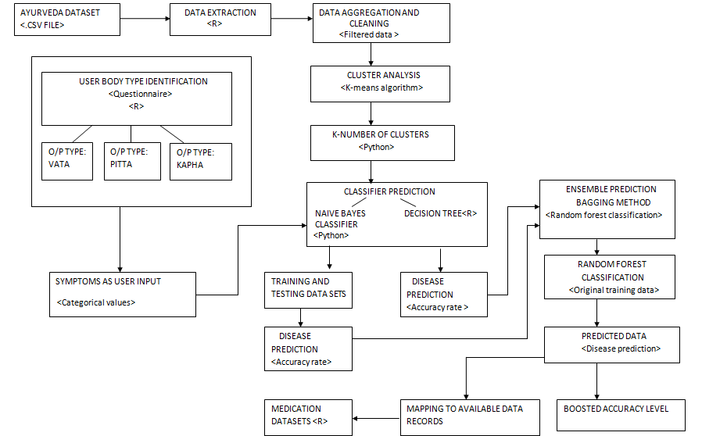
ARCHITECTURE DIAGRAM:

Slide 14
MODULE 1 - IDENTIFICATION OF BODY TYPE:
INPUT:
Answers to physical, mental, fitness and emotional questions.
OUTPUT:
Body type. (Vata, Pitta, Kapha).
LANGUAGE:
R language with shiny library.
DETAILS:
1. Questions are posed and each answers corresponding to one particular body type’s score will be incremented.
2. The one with the highest score is the body type.

Slide 15
MODULES SPLITUP
MODULE 2 – CLUSTERING OF DATA SETS USING K-MEANS ALGORITHM:
INPUT:
Pre-processed datasets.
OUTPUT:
K-number of clusters.
ALGORITHM:
1.Initialize the center of the clusters.
2.Attribute the closest cluster to each data point.
3. Set the position of each cluster to the mean of all data points belonging to that cluster.
4. Repeat steps 2-3 until convergence.
DETAILS:
1. K-means clustering is a method of vector quantization which is used for analysis in data mining.
2. This algorithm aims to partition n observations in to clusters in which each observation belongs to the cluster with the nearest mean, serving as a prototype of the cluster

Slide 16
CLASSIFICATION Vs REGRESSION
Both are related to prediction where
i) Regression predicts a value from a continuous set
ii)Classification predicts the 'belonging' to the class.
Classification trees have dependent variables that are categorical and
unordered.
Regression trees have dependent variables that are continuous
values or ordered whole values.

Slide 17
MODULE 3- DISEASE PREDICTION:
This module includes predicting the type of disease from the symptoms.
Normalising the datasets.
Accuracy rates must be analysed.
Ensemble prediction is to be used.
Prediction methods include:
Naive Bayes Classifier
Decision Tree Approach
Ensemble Prediction

Slide 18
1.NAIVE BAYES CLASSIFIER:
DETAILS:
Bayes theorem provides a way of calculating the posterior probability: P(c|x) from P(c), P(x), and P(x|c).
Naive Bayes Classifier assume that the effect of the value of a predictor (x) on a given class (c) is independent of the values of other predictors.
P(c|x)=P(x|c)*P(c)/P(x)
where,
P(c|x) - Posterior probability of class (target) given predictor (attribute).
P(c) - The prior probability of class.
P(x|c) - Likelihood which is the probability of predictor given class.
P(x) - Prior probability of predictor.

Slide 19
INPUT:
SplitLists List of k sets created by splitting the DataSet
OUTPUT:
TrainingSet, TestSet
ALGORITHM:
BEGIN
{
FOREACH SplitSet Si in SplitLists
{
SET TestSet = Si
SET TrainingSet = Remaining sets merged
}
}
END

Slide 20
INPUT: SplitLists
OUTPUT: Accuracy of Classifier
ALGORITHM:
BEGIN
{
SET noOfSplits = k
FOR noOfSplits = 1 to k
{ Set correctClassificationCount to 0SplitLists
Call SetTrainingSetAndTestSet with
FOREACH TestInstance Ti in TestSet
{
CALL TrainClassifier with TrainingSet
CALL ClassifyTestData with Ti
IF classification = Ti.Class THEN
INCREMENT correctClassificationCount
ENDIF
}
CALL CalculateAccuracy with correctClassificationCount and TestSet.Count
RETURNING Accuracy
}
Calculate average accuracy
} END

Slide 21
2. DECISION TREE ALGORITHM :
DETAILS:
Decision tree is a graph to represent choices and their results in form of a tree.
The nodes in the graph represent an event or choice and the edges of the graph represent the decision rules or conditions.

Slide 22
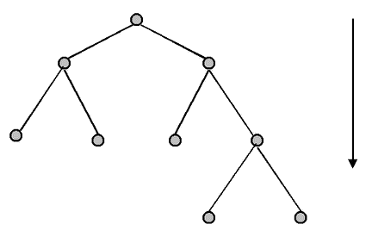
INPUT:
T (Decision Tree)
D (Input database)
OUTPUT:
M (Model prediction)
ALGORITHM:
for each t belongs to D do
n=root node of T
while n not leaf node do
obtain answer to question on n applied t
Identify arc from t which has correct answer
n=node at the end of this arc
Make prediction for t based on labelling of n.

Slide 23
3. ENSEMBLE PREDICTION:
An ensemble is a group of predictors each of which gives an estimate of a target variable.
Ensemble learning is a way to combine these predictions with the goal that the generalization error of the combination is lesser than each of the individual predictors.
The success of ensembling lies in the ability to exploit (or inject and exploit) diversity in the individual predictors.
Ensemble methods involve group of predictive models to achieve a better accuracy and model stability. Ensemble methods are known to impart supreme boost to tree based models.
There are 3 ensembling methods.
Bagging
Boosting
Stacking

Slide 24
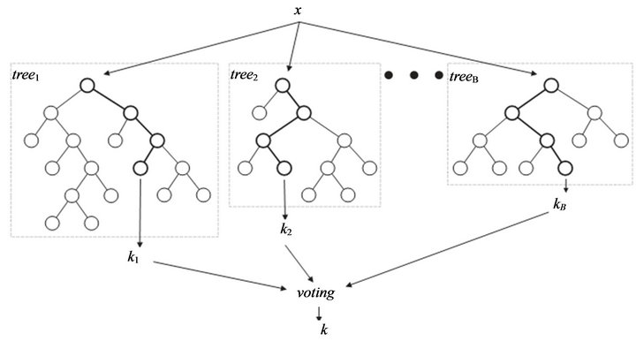
RANDOM FOREST CLASSIFICATION:
INPUT:
Original training data
OUTPUT:
Predicted Data
ALGORITHM:
x<-cbind(x_train,y_train)
output<-randomForest()
summary(output)
predicted=predict(output,x_test)
DETAILS:
Assume number of cases in the training set is N. Then, sample of these N cases is taken at random but with replacement. This sample will be the training set for growing the tree.
If there are M input variables, a number m<M is specified such that at each node, m variables are selected at random out of the M. The best split on these m is used to split the node. The value of m is held constant while we grow the forest.
Each tree is grown to the largest extent possible and there is no pruning.
Predict new data by aggregating the predictions of the ntree trees (i.e., majority votes for
classification, average for regression).

Slide 25
MODULE 4- MEDICINE SUGGESTION:
INPUT:
Predicted variable.
OUTPUT:
Medicine and herb data.
ALGORITHM:
open medication data sets.
check if rowname=predicted variable
if(yes)
retrieve corresponding column data
else
No medication found.

Slide 26
MODULE 5 - WEB APPLICATION:
The web application module includes identifying the body type of the user using eight fold or ten fold examination.
This will be in the form of quiz by enquiring the user’s physical, mental , emotional and fitness features.
The body type can be either Vata, Pitta or Kapha or it can also be any of the combinations of these three body type.
Based on the body type of the user ,the user will be redirected to a corresponding webpage to input symptoms.
Disease is predicted with the corresponding Ayurvedic treatments and medications.
Web application is developed using shiny R.

Slide 27
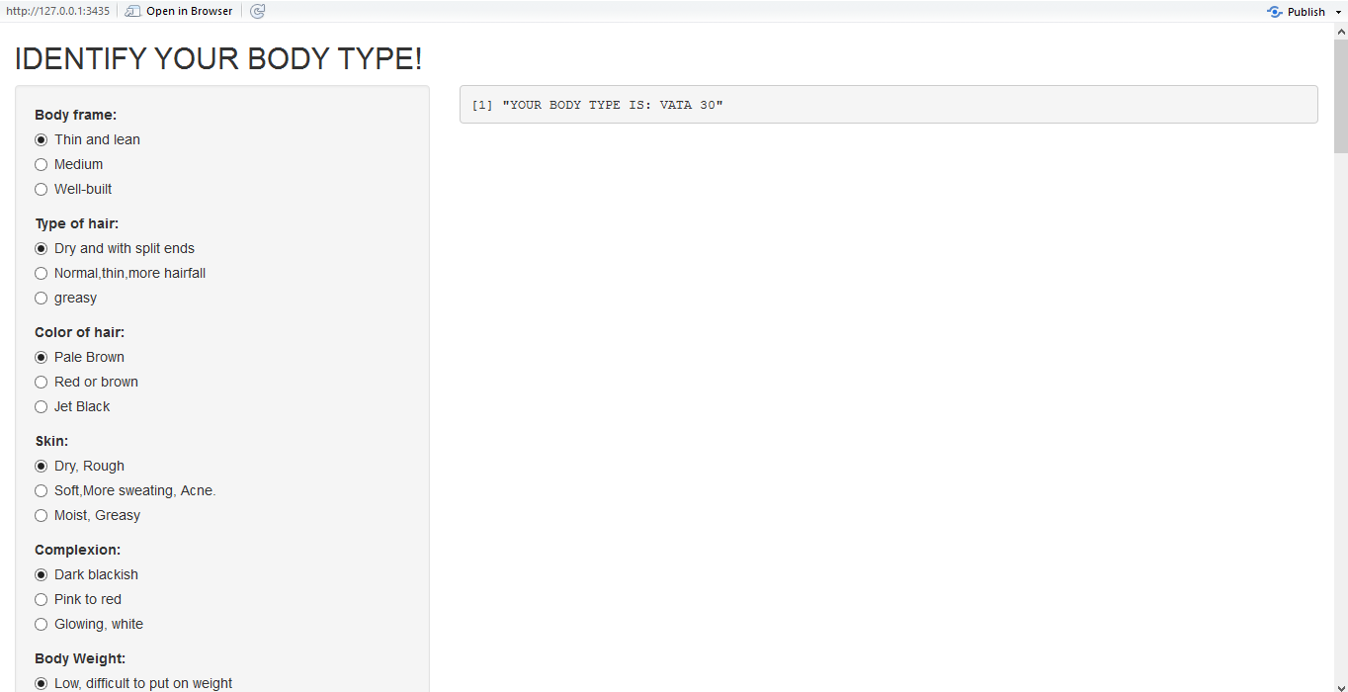
IMPLEMENTATION DETAILS:
A user interface which poses physical, mental and fitness questions with options is developed. The user needs to answer all the questions to identify the body type. This was developed in Rstudio using Shiny library.

Slide 28
METRICS FOR EVALUATION:
ACCURACY :
Accuracy refers to the closeness of a measured value to a standard or known value.
Accuracy=∑ R(terms)/ ∑ N(terms)

Slide 29
REFERENCES:
1. J. Sheng, F. Li and S. T. C. Wong, "Optimal Drug Prediction From Personal Genomics Profiles," in IEEE Journal of Biomedical and Health Informatics, vol. 19, no. 4, pp. 1264-1270, July 2015.
2. Shiva Ayyadurari, V.A. (2014),'The control systems engineering foundation of traditional Indian medicine: the Rosetta Stone for Siddha and Ayurveda', Int. J. System of Systems Engineering , Vol. 5, No. 2, pp. 125-149.
3. Chatterjee B, Pancholi J. Prakriti-based medicine: A step towards personalized medicine. Ayu. 2011;32(2):141-146.

Slide 30
REFERENCES:
4. Collins H, Calvo S, Greenberg K, Forman Neall L, Morrison S. Information Needs in the Precision Medicine Era: How Genetics Home Reference Can Help. Eysenbach G, ed. Interactive Journal of Medical Research. 2016;5(2):e13.
5. Mullane SA, Van Allen EM. Precision medicine for advanced prostate cancer. Current opinion in urology. 2016;26(3):231-239.
6. Kajal C. Agarwal, Meghana Nagori, Clusters of Ayurvedic Medicines Using Improved K-means Algorithm, Proc. of the Intl. Conf. on Advances in CSEE 2013

Slide 31
REFERENCES:
7. Gadgil VD. Understanding Ayurveda. Journal of Ayurveda and Integrative Medicine. 2010;1(1):77-80.
8. Banerjee S, Debnath P, Debnath PK. Ayurnutrigenomics: Ayurveda-inspired personalized nutrition from inception to evidence. Journal of Traditional and Complementary Medicine. 2015;5(4):228-233.

